Slide 1

OBJECT ORIENTED PROGRAMMING THROUGH C++
PROJECT REVIEW 1&2
MATRIX OPERATION USING C++
PRESENTED BY
JOGI GIREESH (25B11AI427)
G SATISH (25B11AI367)
K SAI VINAY (25B11AI492)
N.BHARATH VENKATA PAVAN (26B21AI084))
GUIDED BY
DR.PRAVEEN KUMAR
CO-GUIDED BY
DR.SRAVAN KUMAR
Assistant Professor
Department of AIML
Assistant Professor
Department of AIML
DEPARTMENT OF
ARTIFICIAL INTELLIGENCE AND MACHINE LEARNING

Slide 2



Contents
Abstract
Introduction
Problem Statement
Objectives
Novelty of the Project
Modules and Functions
Implementation
C++ Concepts Used
Inputs
Expected Outputs
Flowchart
Team Contribution
Conclusion
References

Slide 3
Abstract
The Matrix Operation System is a C++-based application designed to perform and manage different matrix operations in a structured and efficient manner. It allows users to enter matrices and perform operations such as addition, subtraction, multiplication, transpose, determinant and other mathematical calculations. The system uses Object-Oriented Programming concepts, arrays, functions and input validation to provide accurate and organized matrix processing. In addition to basic operations, the system can also provide matrix properties and operation results in an easy-to-understand format.

Slide 4
Introduction
The Matrix Operation System is designed to provide a centralized and efficient way to perform mathematical operations on matrices. Matrix calculations are widely used in mathematics, computer science, engineering, artificial intelligence, graphics and data processing.Performing matrix operations manually becomes difficult when the size of matrices increases. Calculating multiplication, determinant and other operations manually can also lead to calculation errors.The proposed Matrix Operation System aims to solve these problems by providing a C++ application that allows matrices to be entered, processed and displayed efficiently.

Slide 5
Problem Statement
Performing matrix operations manually becomes difficult and time-consuming, especially when the size of the matrices increases. Operations such as addition, subtraction, multiplication, transpose, and determinant calculation require multiple calculations and proper mathematical procedures.
The proposed Matrix Operation System aims to solve these problems by providing a centralized C++ application that allows users to enter matrices, select the required operation, process the data, and obtain accurate results efficiently.
The system also validates matrix dimensions before performing operations, helping to prevent invalid calculations and improving the reliability of the results.

Slide 6
Objectives
To develop a C++ based Matrix Operation System using OOP concepts.
To perform basic matrix operations efficiently.
To perform matrix addition and subtraction.
To perform matrix multiplication.
To validate matrix dimensions before performing operations.
To reduce manual calculation effort.
To provide easy input and retrieval of matrix results.

Slide 7
Novelty of the Project
. Multiple Operations: Performs different matrix operations in a single system.
Dimension Validation: Checks whether matrices are suitable for the selected operation.
Operation Management: Allows users to select the required matrix operation.
Error Reduction: Reduces calculation errors compared with manual processing.
User-Friendly Interface: Provides a simple menu-based way to enter matrices and view results.

Slide 8
Modules & Functions
2. Basic Matrix Operations
Matrix Addition
Matrix Subtraction
Matrix Multiplication
Scalar Multiplication
Functions:
Matrix Management
Create Matrix
Enter Matrix Elements
Display Matrix
Update Matrix
Store Matrix
Functions:
. createMatrix()
inputMatrix()
displayMatrix()
updateMatrix()
addMatrix()
subtractMatrix()
multiplyMatrix()
scalarMultiply()

Slide 9
Modules &Functions
4. Validation Module
Check matrix dimensions
Validate addition/subtraction condition
Validate multiplication condition
Display appropriate error messages
3. Transpose Module
Calculate transpose of a matrix
Convert rows into columns
Display transposed matrix
Functions:
.transposeMatrix()
Functions:
validateDimensions()
checkAddition()
checkMultiplication()

Slide 10
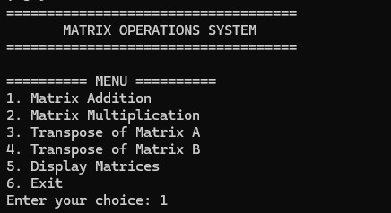
Implementation
Developed using C++ programming language.
Implemented matrix representation using 2D arrays.
Implemented matrix addition and multiplication.
Implemented matrix transpose.
Implemented dimension validation.
Integrated all operations through a menu-driven system.
Used functions to organize different matrix operations.
Tested the system using sample matrix values.

Slide 11
C++ Concepts Used
Object-Oriented Programming
2D Arrays
Functions
Variables
Input / Output
Nested Loops
Switch-case
Conditional Statements
Other C++ Concepts
Classes and Objects
Member Functions
Encapsulation
Constructors
Input Validation

Slide 12
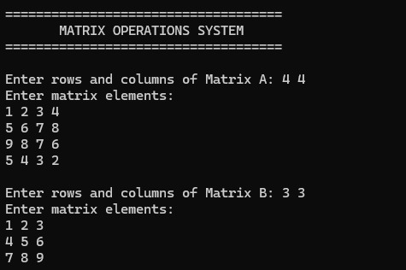
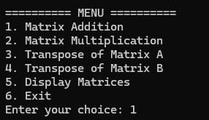
Inputs
Matrix A
Number of Rows
Number of Columns
Matrix Elements
Matrix B
Number of Rows
Number of Columns
Matrix Elements
Operation Selection
Addition
Multiplication
Transpose
Exit

Slide 13
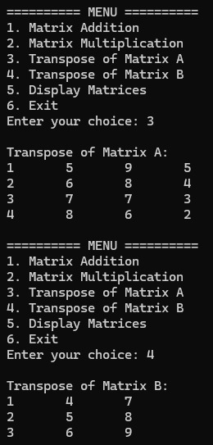
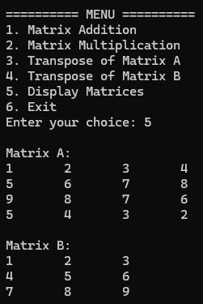
Expected Outputs
Display Matrix A
Display Matrix B
Matrix Multiplication Result
Matrix Addition Result
Matrix Transpose
Dimension Validation Message
Invalid Operation Message
Final Matrix Result

Slide 14
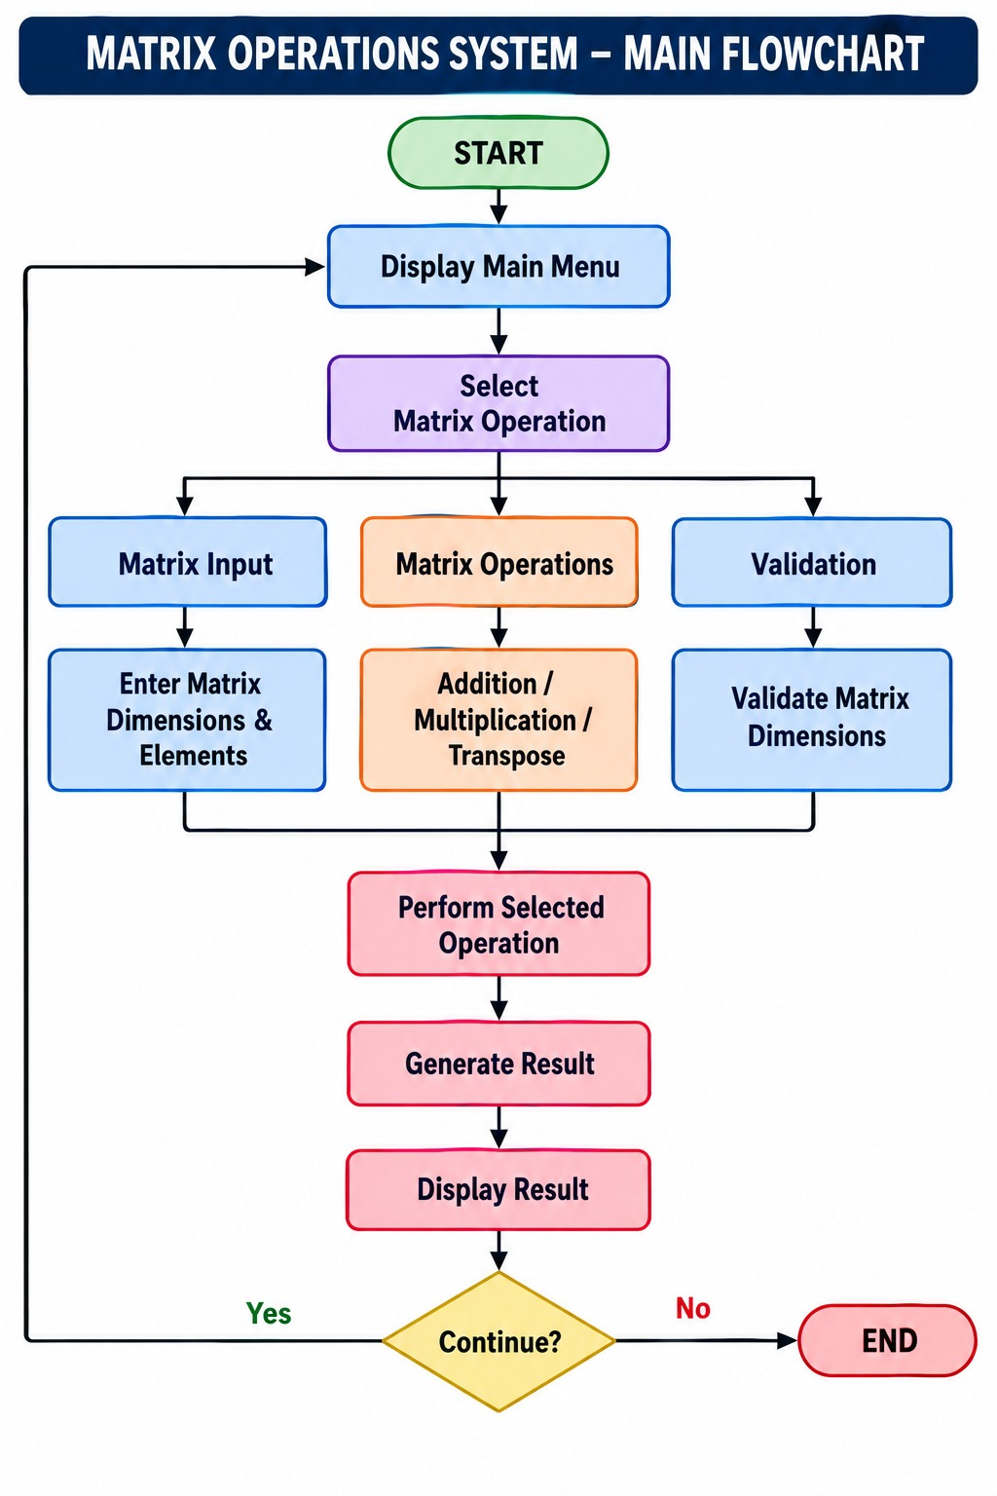

Slide 15
Team Contributions
Member 1 — Team Lead
Overall project coordination
System structure and module flow
Matrix input and display
Module integration
Member 2 — Matrix Operations
Matrix addition
Matrix multiplication
Operation functions
Member 3 — Validation & Testing
Dimension validation
Error handling
Sample-data testing
Debugging
Member 4 — Documentation
Project documentation
PPT preparation
Flowchart
Testing results

Slide 16
Conclusion
The Matrix Operations System successfully provides a simple and efficient way to perform matrix operations using C++. The system supports matrix input, addition, multiplication and transpose operations with proper dimension validation.
The project demonstrates the practical use of 2D arrays, functions, loops, switch-case and conditional statements. It reduces manual calculation effort and helps users obtain accurate matrix results.
Overall, this project helped us apply C++ programming concepts to a practical mathematical application.

Slide 17
References
Aditya University, B.Tech Curriculum 2025 – Object Oriented Programming through C++
Bjarne Stroustrup, The C++ Programming Language, 4th Edition, Addison-Wesley.
Robert Lafore, Object-Oriented Programming in C++, 4th Edition, Sams Publishing.
Herbert Schildt, C++: The Complete Reference, McGraw-Hill Education.
.
C++ Reference, Standard C++ Library Documentation — cppreference.com

Slide 18
Thank You

